Slide 1

Lesson: 1.04 Variable input
Microsoft Philanthropies TEALS Program
Introduction to computer science

Slide 2
Variable Input
After this lesson, you will be able to...
Define and identify comments, storing, mutability, variable assignment, input
Assign and swap variables
Store user input into a variable

Slide 3
Plan
Do now
Continue do now & discussion
Magic genie lab
Debrief/quiz prep
Notes:
5 Minutes - Do Now
20 Minutes - Continue Do Now & Discussion
20 Minutes - Magic Genie Lab
10 Minutes - Debrief/Quiz Prep

Slide 4
Do now
Type the following in your Notebook
  a = input("What is your name? ")
  # a = "cats and dogs“
  # meow
  print("Hello there, " + a)
In Your Notebook, respond to the following
  Read through the code and write down what you expect the printed results to be?
  Run the code and write down the actual printed result?
  Briefly describe what the # does?
  Briefly describe what input does?

Slide 5
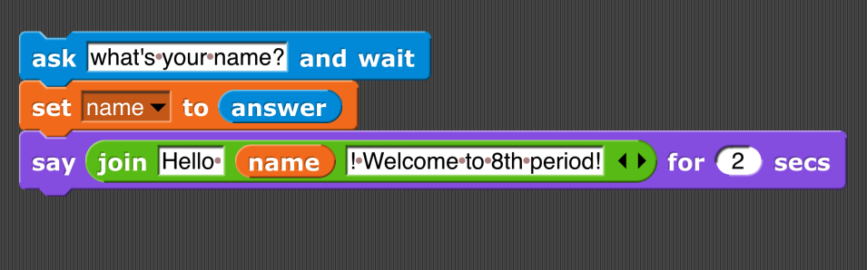
Discussion - What does the code do?

Slide 6
Code comment
What happens when I run the statement above?
A: Absolutely nothing!
Why?
A: Because “#” makes it a comment

Slide 7
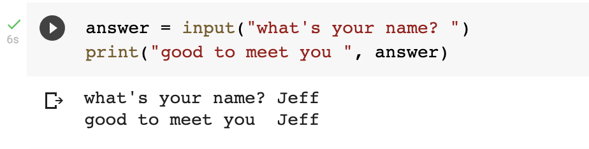
Input statement
What’s the input statement for?
A: Lets you input data and save it to a variable

Slide 8
Input statement - string
BTW, what’s the data type of value saved to answer?
A: It’s a string. The input statement always returns a string.

Slide 9

Input statement - error
What will happen when I run this code?
A: It will give me an error!

Slide 10

Input statement – int()

Slide 11
Lab – magic genie
Project objective
Use Python to interact with variables and user input
Create a genie program. Save the file as magic_genie.ipynb.

Slide 12
Project specifications
Have the program introduce itself
Have the program ask for three separate wishes
Print all the wishes together
There are some repeated strings in this genie program
  Move those into variables
Image of Output. Here is the test
I am a genie. You have three wishes
What would you like to wish for? cats
What would you like to wish for? kittens
What would you like to wish for? more cats
Your wishes are cats, kittens and more cats

Slide 13
Genie Confusion
Now it’s time to make your genie confused
Edit your code to have him
  Print your first wish as your last wish
  Your second wish as your first wish
  Your third wish as your second wish
I am a genie. You have three wishes
What would you like to wish for? cats
What would you like to wish for? kittens
What would you like to wish for? More cats
Your wishes are kittens, more cats and cats

Slide 14
Hint
Remember to add spaces. You can combine " " to the end of your string using the + operator
So print("hello" + " " + "student") would print hello student

Slide 15
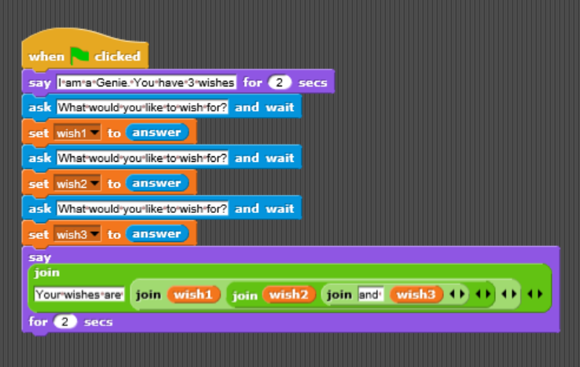
Snap! Flashback
Look at how you would write this code in Snap!

Slide 16
Exit ticket/debrief
In your notebook, write down one thing you learned today.

